Slide 1
ECE 532
CHAPTER 2: FUNDAMENTAL DATA STRUCTURES: STACKS APPLICATION (PART 1: INFIX, PREFIX AND POSTFIX CALCULATION)
Lecturer: Dr. Roslina Mohamad
Room: Tower 2, Level 13, No:14C

Slide 2
Learning Outcomes
At the end of this lecture, you will be able to:
Discover stack applications in infix, postfix and prefix operation

Slide 3
Application of Stacks: Postfix Expressions Calculator
Infix notation: usual notation for writing arithmetic expressions
The operator is written between the operands
Example: a + b
The operators have precedence
Parentheses can be used to override precedence

Slide 4
Application of Stacks: Postfix Expressions Calculator
Prefix (Polish) notation: the operators are written before the operands
Introduced by the Polish mathematician Jan Lukasiewicz
Early 1920s
The parentheses can be omitted
Example: + a b

Slide 5
Application of Stacks: Postfix Expressions Calculator
Reverse Polish notation: the operators follow the operands (postfix operators)
Proposed by the Australian philosopher and early computer scientist Charles L. Hamblin
Late 1950's
Advantage: the operators appear in the order required for computation
Example: a + b * c
In a postfix expression: a b c * +

Slide 6
Example
Use standard calculator to calculate
2 + 4 x 6=?
Repeat the calculation using scientific calculator?

Slide 7
Postfix and Prefix Examples
INFIX RPN (POSTFIX) PREFIX
A + B A * B + C A * (B + C) A - (B - (C - D)) A - B - C - D
A B +
+ A B
A B * C +
+ * A B C
A B C + *
* A + B C
A B C D---
-A-B-C D
A B-C-D-
---A B C D
Prefix : Operators come before the operands

Slide 8
Prefix evaluation
scan left to right until we find the first operator immediately followed by pair of operands
evaluate expression, and replace the “used” operator & operands with the result
continue until a single value remains

Slide 9
Prefix Example
+ * / 4 2 3 9 // original expression
+ * 2 3 9 // 4/2 evaluated
+ 6 9 // 2*3 evaluated
15 // 6+9 evaluated

Slide 10
Another example
* - + 4 3 5 / + 2 4 3 // original expression
* - 7 5 / + 2 4 3 // 4+3 evaluated
* 2 / + 2 4 3 // 7-5 evaluated
* 2 / 6 3 // 2+4 evaluated
* 2 2 // 6/3 evaluated
4 // 2*2 evaluated

Slide 11
Prefix summary
Operands (but often not operators) same order as infix
Expression designated unambiguously without parentheses
Improvement on infix, but still not quite as simple to evaluate as one might wish -- have to deal with exceptions

Slide 12
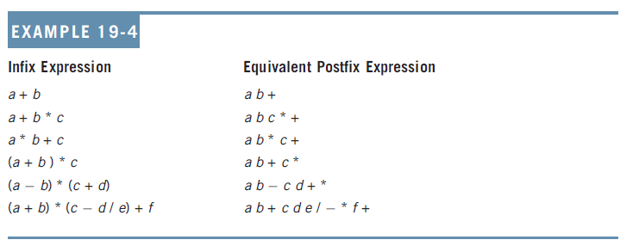
Application of Stacks: Postfix Expressions Calculator

Slide 13
Application of Stacks: Postfix Expressions Calculator
Postfix notation has important applications in computer science
Many compilers first translate arithmetic expressions into postfix notation and then translate this expression into machine code
Evaluation algorithm:
Scan expression from left to right
Using STACK ALGORITHM

Slide 14
Application of Stacks
Consider the arithmetic statement in the assignment statement:
x = a * b + c
Compiler must generate machine instructions
LOAD a
MULT b
ADD c
STORE x
Note: this is "infix" notation
The operators are between the operands

Slide 15
RPN or Postfix Notation
Most compilers convert an expression in infix notation to postfix
the operators are written after the operands
So a * b + c becomes a b * c +
Advantage:
expressions can be written without parentheses

Slide 16
Evaluating RPN Expressions
"By hand" (Underlining technique):
1. Scan the expression from left to right to find an operator.
2. Locate ("underline") the last two preceding operands and combine them using this operator.
3. Repeat until the end of the expression is reached.
Example:
2 3 4 + 5 6 - - *
→ 2 3 4 + 5 6 - - *
→ 2 7 5 6 - - *
→ 2 7 5 6 - - *
→ 2 7 -1 - *
→ 2 7 -1 - * →
2 8 * →
2 8 * →
16

Slide 17
Evaluating RPN Expressions
By using a stack algorithm
Initialize an empty stack
Repeat the following until the end of the expression is encountered (Read expression from left to right)
Get the next token (const, var, operator) in the expression
Operand – push onto stack Operator – do the following
Pop 2 values from stack
Apply operator to the two values
Push resulting value back onto stack
When end of expression encountered, value of expression is the (only) number left in stack
Note: if only 1 value on stack, this is an invalid RPN expression

Slide 18
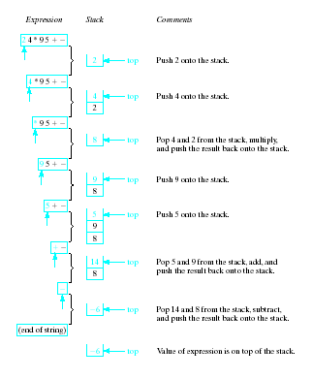
Evaluation of Postfix
Note the changing status of the stack

Slide 19
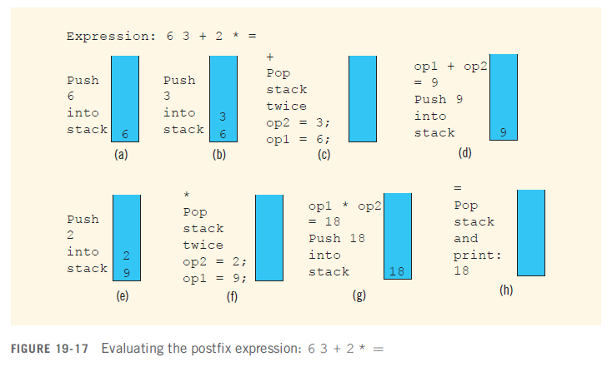
Application of Stacks: Postfix Expressions Calculator
Example: 6 3 + 2 * =

Slide 20
See PostfixCalculation

Slide 21
Using Table to perform stack operation Example: 2 3 4 + 5 6 - - *
Symbol | Stack | Operation
2 | 2
3 | 2,3
4 | 2,3,4
+ | 2,7 | 3 + 4 = 7
5 | 2,7,5
6 | 2,7,5,6
- | 2,7,-1 | 5 - 6 = -1
- | 2,8 | 7- (-1) = 8
* | 16 | 2 * 8 = 16

Slide 22
Application of Stacks: Postfix Expressions Calculator
Symbols can be numbers or anything else:
+, -, *, and / are operators
Pop stack twice and evaluate expression
If stack has less than two elements ➔ error
If symbol is =, the expression ends
Pop and print answer from stack
If stack has more than one element ➔ error
If symbol is anything else
Expression contains an illegal operator

Slide 23
Application of Stacks: Postfix Expressions Calculator
Examples:
7 6 + 3 ; 6 - =
; is an illegal operator
14 + 2 3 * =
Does not have enough operands for +
14 2 3 + =
Error: stack will have two elements when we encounter equal (=) sign

Slide 24
Prefix calculation using stack algorithm?

Slide 25
Evaluating Prefix Expressions
"By hand" (Underlining technique):
1. Scan the expression from right to left to find an operator.
2. Locate ("underline") the last two preceding operands and combine them using this operator.
3. Repeat until the end of the expression is reached.
Example
* - + 4 3 5 / + 2 4 3

Slide 26
Evaluating Prefix Expressions
By using a stack algorithm
Initialize an empty stack
Repeat the following until the end of the expression is encountered (Read expression from right to left)
Get the next token (const, var, operator) in the expression
Operand – push onto stack Operator – do the following
Pop 2 values from stack
Apply operator to the two values
Push resulting value back onto stack
When end of expression encountered, value of expression is the (only) number left in stack
Note: if only 1 value on stack, this is an invalid Prefix expression

Slide 27
Using Table to perform stack operation Example: * - + 4 3 5 / + 2 4 3
Symbol | Stack | Operation
3 | 3
4 | 3,4
2 | 3,4,2
+ | 3,6 | 2 + 4 = 6
/ | 2 | 6 / 3 = 2
5 | 2,5
3 | 2,5,3
4 | 2,5,3,4
+ | 2,5,7 | 4 + 3 =7
- | 2,2 | 7 – 5 = 2
* | 4 | 2*2 = 4

